Slide 1
SYSTEM DEVELOPMENT METHODOLOGY
EMoS 6308

Slide 2
Software Process Models
Dr. Devotha Nyambo
2
These slides are designed and adapted from slides provided by Software Engineering: A Practitioner’s Approach, 7/e (McGraw-Hill 2009) by Roger Pressman and Software Engineering 9^{/e} Addison Wesley 2011 by Ian Sommerville with some additional content
Notes:
2

Slide 3
Social Learning Process
Software is embodied knowledge that is initially dispersed, tacit and incomplete.
In order to convert knowledge into software, dialogues are needed between users and designers, between designers and tools to bring knowledge into software.
Software development is essentially an iterative social learning process, and the outcome is “software capital”.
3

Slide 4
What / who / why is Process Models?
What: Go through a series of predictable steps--- a road map that helps you create a timely, high-quality results.
Who: Software engineers and their managers, clients also. People adapt the process to their needs and follow it.
Why: Provides stability, control, and organization to an activity that can if left uncontrolled, become quite chaotic. However, modern software engineering approaches must be agile and demand ONLY those activities, controls and work products that are appropriate.
What Work products: Programs, documents, and data
4

Slide 5
What / who / why is Process Models?
What are the steps: The process you adopt depends on the software that you are building. One process might be good for aircraft avionic system, while an entirely different process would be used for website creation.
How to ensure right: A number of software process assessment mechanisms that enable us to determine the maturity of the software process. However, the quality, timeliness and long-term viability of the software are the best indicators of the efficacy of the process you use.
5

Slide 6
Definition of Software Process
A framework for the activities, actions, and tasks that are required to build high-quality software.
SP defines the approach that is taken as software is engineered.
Is not equal to software engineering, which also encompasses technologies that populate the process– technical methods and automated tools.
6

Slide 7
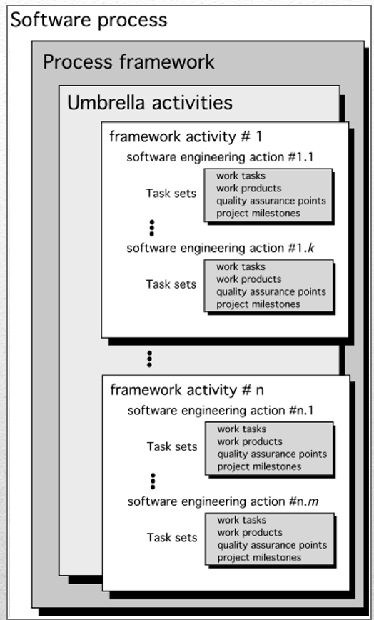
A Generic Process Model
7

Slide 8
A Generic Process Model
As we discussed before, a generic process framework for software engineering defines five framework activities-communication, planning, modeling, construction, and deployment.
In addition, a set of umbrella activities- project tracking and control, risk management, quality assurance, configuration management, technical reviews, and others are applied throughout the process.
8

Slide 9
A Generic Process Model
Next question is: how the framework activities and the actions and tasks that occur within each activity are organized with respect to sequence and time? See the process flow for answer.
9

Slide 10
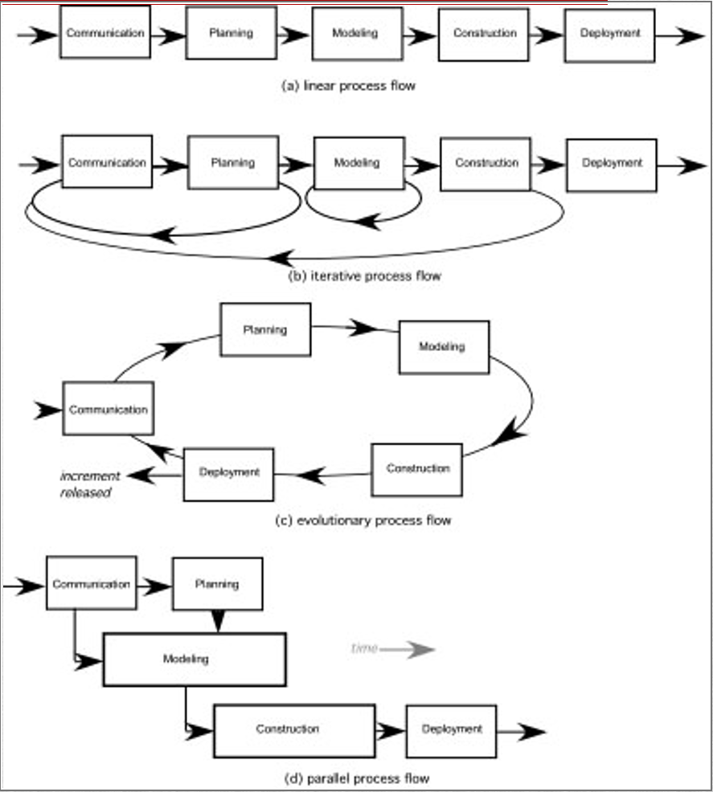
Process Flow
10

Slide 11
Linear process flow executes each of the five activities in sequence.
An iterative process flow repeats one or more of the activities before proceeding to the next.
An evolutionary process flow executes the activities in a circular manner. Each circuit leads to a more complete version of the software.
A parallel process flow executes one or more activities in parallel with other activities ( modeling for one aspect of the software in parallel with construction of another aspect of the software.
11

Slide 12
Identifying a Task Set
Before you can proceed with the process model, a key question: what actions are appropriate for a framework activity given the nature of the problem, the characteristics of the people and the stakeholders?
A task set defines the actual work to be done to accomplish the objectives of a software engineering action.
A list of the task to be accomplished
A list of the work products to be produced
A list of the quality assurance filters to be applied
12

Slide 13
Identifying a Task Set
For example, a small software project requested by one person with simple requirements, the communication activity might encompass little more than a phone call with the stakeholder. Therefore, the only necessary action is phone conversation, the work tasks of this action are:
1. Make contact with stakeholder via telephone.
2. Discuss requirements and take notes.
3. Organize notes into a brief written statement of requirements.
4. E-mail to stakeholder for review and approval.
13

Slide 14
Example of a Task Set for Elicitation
The task sets for Requirements gathering action for a simple project may include:
Make a list of stakeholders for the project.
Invite all stakeholders to an informal meeting.
Ask each stakeholder to make a list of features and functions required.
Discuss requirements and build a final list.
Prioritize requirements.
Note areas of uncertainty.
14

Slide 15
Example of a Task Set for Elicitation
The task sets for Requirements gathering action for a big project may include:
Make a list of stakeholders for the project.
Interview each stakeholders separately to determine overall wants and needs.
Build a preliminary list of functions and features based on stakeholder input.
Schedule a series of facilitated application specification meetings.
Conduct meetings.
Produce informal user scenarios as part of each meeting.
Both do the same work with different depth and formality. Choose the task sets that achieve the goal and still maintain quality and agility.
15

Slide 16
Example of a Task Set for Elicitation
The task sets for Requirements gathering action for a big project may include:...
7. Refine user scenarios based on stakeholder feedback.
8. Build a revised list of stakeholder requirements.
9. Use quality function deployment techniques to prioritize requirements.
10. Package requirements so that they can be delivered incrementally.
11. Note constraints and restrictions that will be placed on the system.
12. Discuss methods for validating the system.
Both do the same work with different depth and formality. Choose the task sets that achieve the goal and still maintain quality and agility.
16

Slide 17
Process Patterns
A process pattern
describes a process-related problem that is encountered during software engineering work,
identifies the environment in which the problem has been encountered, and
suggests one or more proven solutions to the problem.
Stated in more general terms, a process pattern provides you with —a consistent method for describing problem solutions within the context of the software process.
Problems and solutions associated with a complete process model (e.g. prototyping).
Problems and solutions associated with a framework activity (e.g. planning) or
An action with a framework activity (e.g. project estimating).
17

Slide 18
Process Pattern Types
Stage patterns—defines a problem associated with a framework activity for the process. It includes multiple task patterns as well. For example, Establishing Communication would incorporate the task pattern Requirements Gathering and others.
Task patterns—defines a problem associated with a software engineering action or work task and relevant to successful software engineering practice
Phase patterns—define the sequence of framework activities that occur with the process, even when the overall flow of activities is iterative in nature. Example includes Sprial Model or Prototyping.
18

Slide 19
Process Models

Slide 20
Prescriptive Models
Originally proposed to bring order to chaos.
Prescriptive process models advocate an orderly approach to software engineering. However, will some extent of chaos (less rigid) be beneficial to bring some creativity?
That leads to a few questions …
If prescriptive process models strive for structure and order (prescribe a set of process elements and process flow), are they inappropriate for a software world that thrives on change?
Yet, if we reject traditional process models (and the order they imply) and replace them with something less structured, do we make it impossible to achieve coordination and coherence in software work?
20

Slide 21
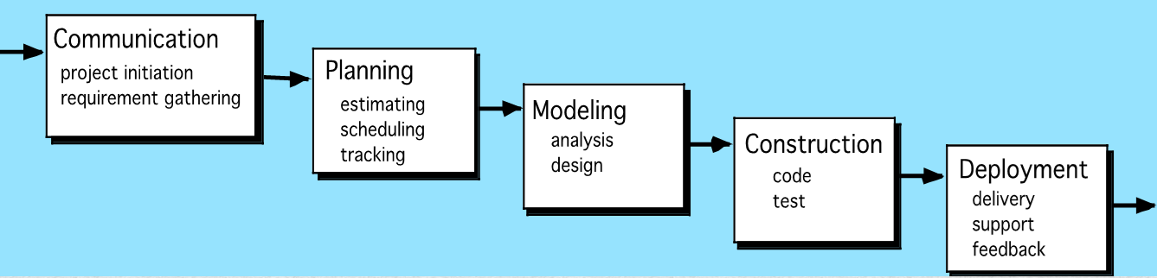
The Waterfall Model
It is the oldest paradigm for SE. When requirements are well defined and reasonably stable, it leads to a linear fashion.
(problems: 1. rarely linear, iteration needed. 2. hard to state all requirements explicitly. Blocking state. 3. code will not be released until very late.)
The classic life cycle suggests a systematic, sequential approach to software development.
21

Slide 22
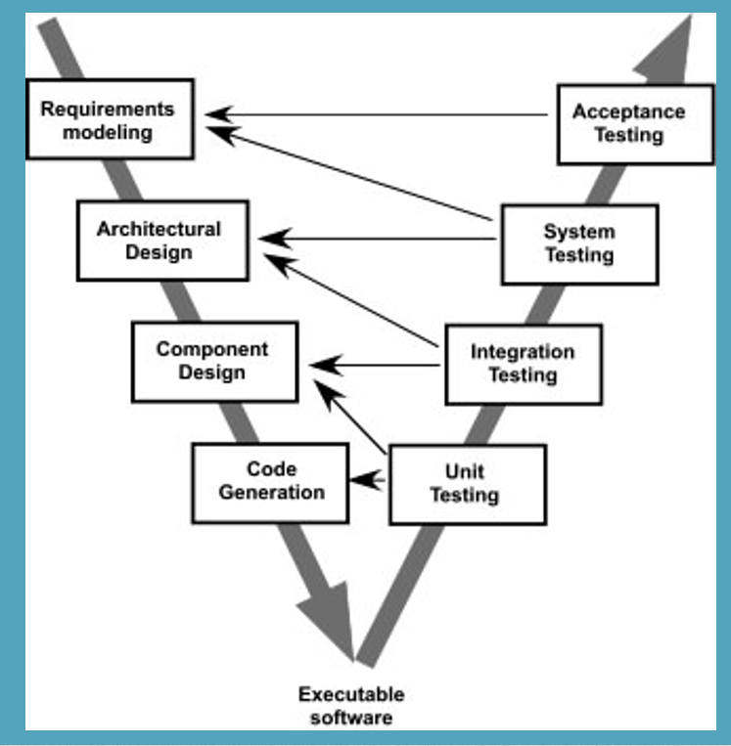
The V-Model
A variation of waterfall model depicts the relationship of quality assurance actions to the actions associated with communication, modeling and early code construction activates.
Team first moves down the left side of the V to refine the problem requirements. Once code is generated, the team moves up the right side of the V, performing a series of tests that validate each of the models created as the team moved down the left side.
22

Slide 23
The Incremental Model
When initial requirements are reasonably well defined, but the overall scope of the development effort precludes a purely linear process. A compelling need to expand a limited set of new functions to a later system release.
It combines elements of linear and parallel process flows. Each linear sequence produces deliverable increments of the software.
The first increment is often a core product with many supplementary features. Users use it and evaluate it with more modifications to better meet the needs.
23

Slide 24
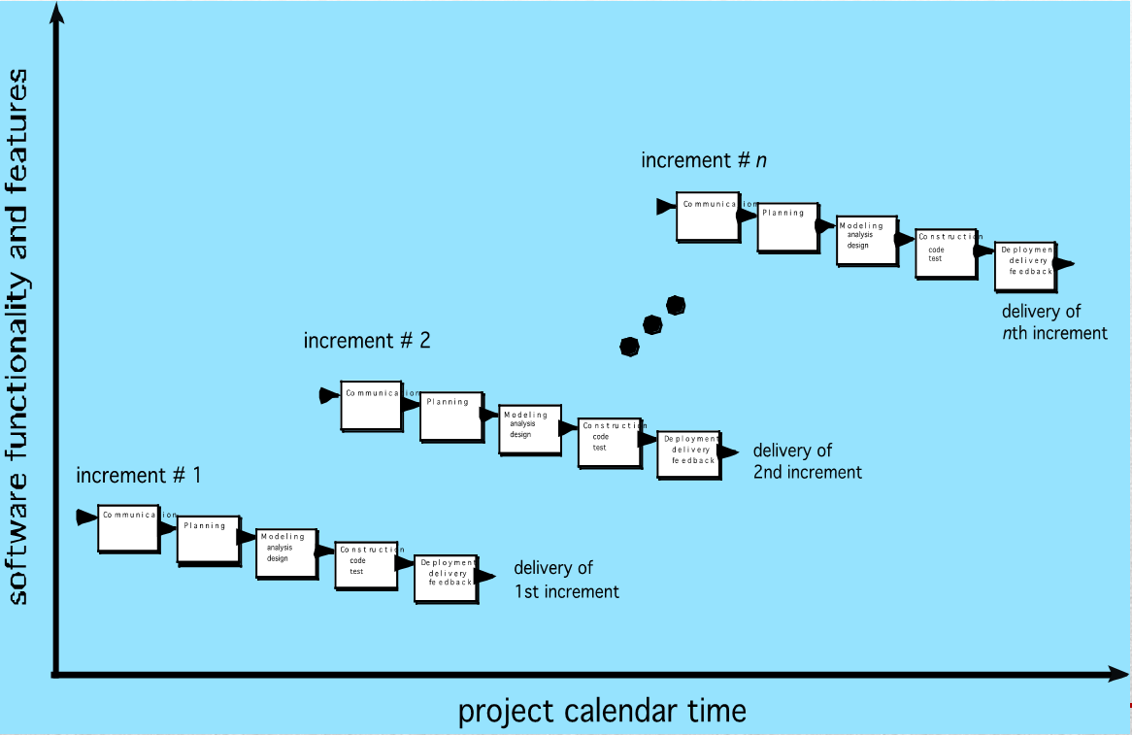
The Incremental Model
24

Slide 25
Evolutionary Models
Software system evolves over time as requirements often change as development proceeds. Thus, a straight line to a complete end product is not possible. However, a limited version must be delivered to meet competitive pressure.
Usually a set of core product or system requirements is well understood, but the details and extension have yet to be defined.
25

Slide 26
Evolutionary Models
You need a process model that has been explicitly designed to accommodate a product that evolve over time.
It is the iterations that enables you to develop increasingly more complete version of the software.
Two types are introduced, namely Prototyping and Spiral models.
26

Slide 27
Evolutionary Models: Prototyping
When to use: Customer defines a set of general objectives but does not identify detailed requirements for functions and features. Or Developer may be unsure of the efficiency of an algorithm, the form that human computer interaction should take.
What step: Begins with communication by meeting with stakeholders to define the objective, identify whatever requirements are known, outline areas where further definition is mandatory. A quick plan for prototyping and modeling (quick design) occur.
27

Slide 28
Evolutionary Models: Prototyping
Quick design focuses on a representation of those aspects the software that will be visible to end users ( interface and output). Design leads to the construction of a prototype which will be deployed and evaluated. Stakeholder’s comments will be used to refine requirements.
Both stakeholders and software engineers like the prototyping paradigm. Users get a feel for the actual system, and developers get to build something immediately. However, engineers may make compromises in order to get a prototype working quickly. The less-than-ideal choice may be adopted forever after you get used to it.
28

Slide 29
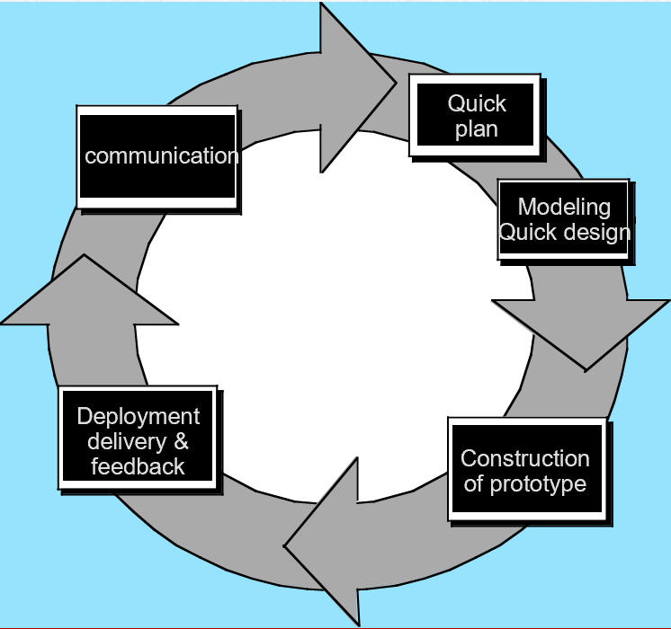
Evolutionary Models: Prototyping
29

Slide 30
Evolutionary Models: The Spiral
It couples the iterative nature of prototyping with the controlled and systematic aspects of the waterfall model and is a risk-driven process model generator that is used to guide multi-stakeholder concurrent engineering of software intensive systems.
Two main distinguishing features: one is cyclic approach for incrementally growing a system’s degree of definition and implementation while decreasing its degree of risk. The other is a set of anchor point milestones for ensuring stakeholder commitment to feasible and mutually satisfactory system solutions.
A series of evolutionary releases are delivered. During the early iterations, the release might be a model or prototype. During later iterations, increasingly more complete version of the engineered system are produced.
30

Slide 31
Evolutionary Models: The Spiral
The first circuit in the clockwise direction might result in the product specification; subsequent passes around the spiral might be used to develop a prototype and then progressively more sophisticated versions of the software. Each pass results in adjustments to the project plan. Cost and schedule are adjusted based on feedback. Also, the number of iterations will be adjusted by project manager.
Good to develop large-scale system as software evolves as the process progresses and risk should be understood and properly reacted to. Prototyping is used to reduce risk.
However, it may be difficult to convince customers that it is controllable as it demands considerable risk assessment expertise.
31

Slide 32
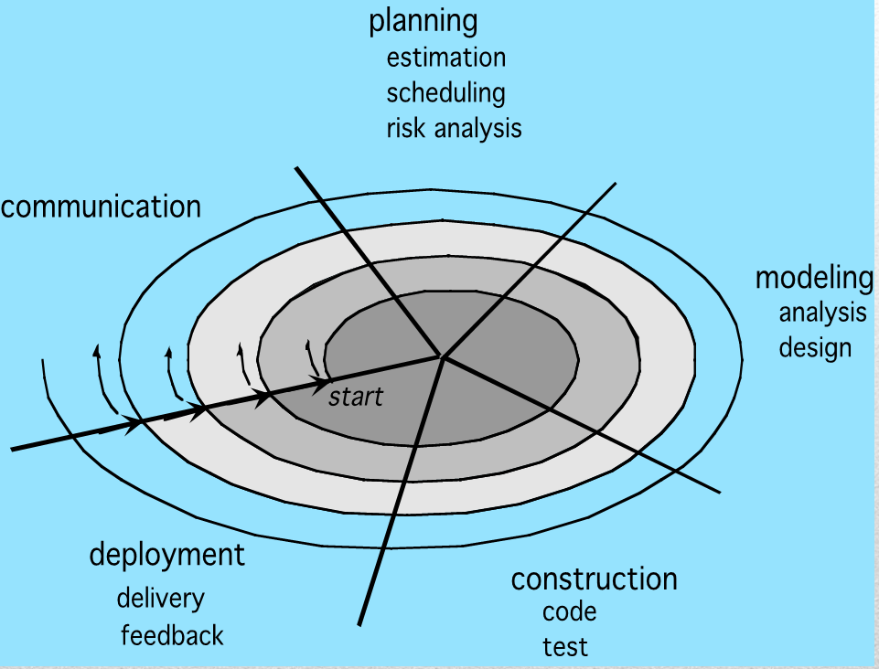
Evolutionary Models: The Spiral
32

Slide 33
Three Concerns on Evolutionary Processes
First concern is that prototyping poses a problem to project planning because of the uncertain number of cycles required to construct the product.
Second, it does not establish the maximum speed of the evolution. If the evolution occur too fast, without a period of relaxation, it is certain that the process will fall into chaos. On the other hand if the speed is too slow then productivity could be affected.
Third, software processes should be focused on flexibility and extensibility rather than on high quality. We should prioritize the speed of the development over zero defects. Extending the development in order to reach high quality could result in a late delivery of the product when the opportunity niche has disappeared.
33

Slide 34
Case study
Breakout session

Slide 35
Consider the three case studies during previous sessions:
Computer store
Cake business
Sipps inventory management and distribution
Under each scenario propose whether a prescriptive or evolutionary model would be appropriate. Justify based pros and cons

